Slide 1
RNA-seq analysis is easy as 1-2-3 with
WEHI Masterclass 2021
24 Aug 2021
Instructor: Xueyi Dong

Slide 2
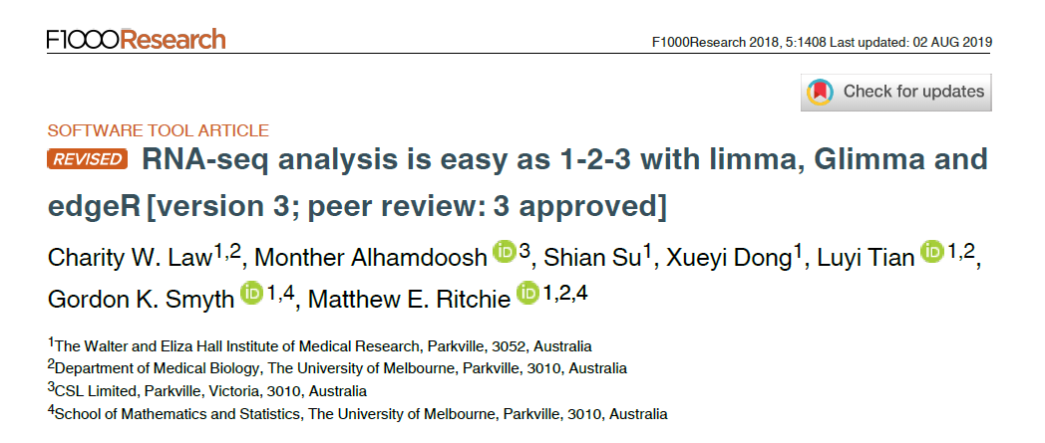
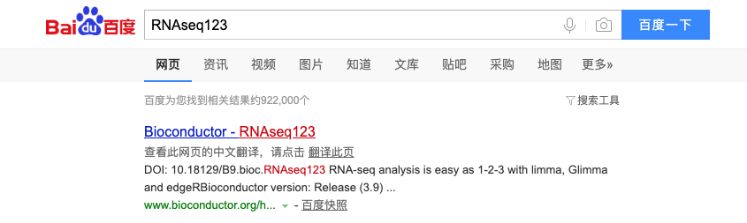

Slide 3
使用RStudio云服务器
访问 http://workshop.bioc.cancerdatasci.org/
下拉菜单选择RNA-seq 123 (Chinese)，并填写你的邮箱地址，点击“submit”
点击“Launch Workshop”，进入Rstudio登录界面
用户名: rstudio
密码: welcome-to-bioc2020

Slide 4
Use Orchestra platform
Visit this Orchestra http://app.orchestra.cancerdatasci.org/. platform (Some participants may need to use a VPN to connect to the Orchestra platform.)
Sign in using your email address and set a password.
From the ‘Choose a workshop’ page, search “WEHI” to find the Masterclass teaching materials for each day.
Select the “Launch” button to access your very own RStudio server instance in the cloud which comes with all the required software and data for the workshop.

Slide 5
If you can’t use Orchestra platform
Follow the instruction on https://xueyidong.github.io/RNAseq123workshop/ to install the R packages or use the Docker image

Slide 6
Introduction
RNA-sequencing is a method to quantify the amount of RNA in a sample
Tells us which genes are active and how much they are transcribed
Measure gene expression levels
Differential expression analysis
Compare gene expression between different groups
Examples:
Compare normal cells to mutated cells
Compare treated cells to control cells

Slide 7
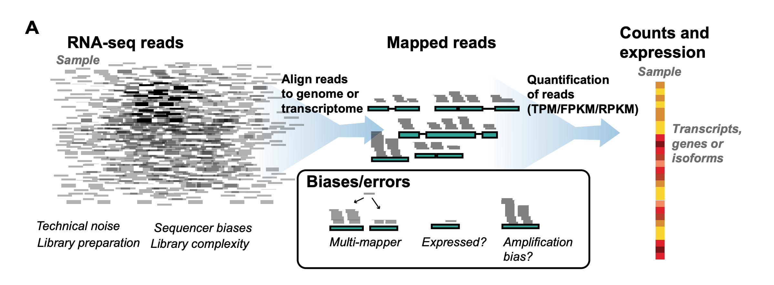
Alignment and counting
Ballouz et al, NAR 2018
Notes:
https://www.ncbi.nlm.nih.gov/pmc/articles/PMC6007662/

Slide 8



RNA-seq overview
Sequence reads – FASTQ files
Align to reference genome
Count number of reads mapped to each gene (counts matrix)
Data pre-processing
Differential expression analysis
Notes:
Can be replaced by schematic

Slide 9
Experimental design
Biological replicates!
Reference samples between different sequencing runs (if adding MORE samples and want to analyse together)
Don’t sequence all of one group on one day, and all of another group on another day! Group will be confounded with sequencing date.
Likewise for any other potential batch effects – sampling date, sequencing date, technician collecting/preparing samples.
Notes:
Credit: Charity Law

Slide 10
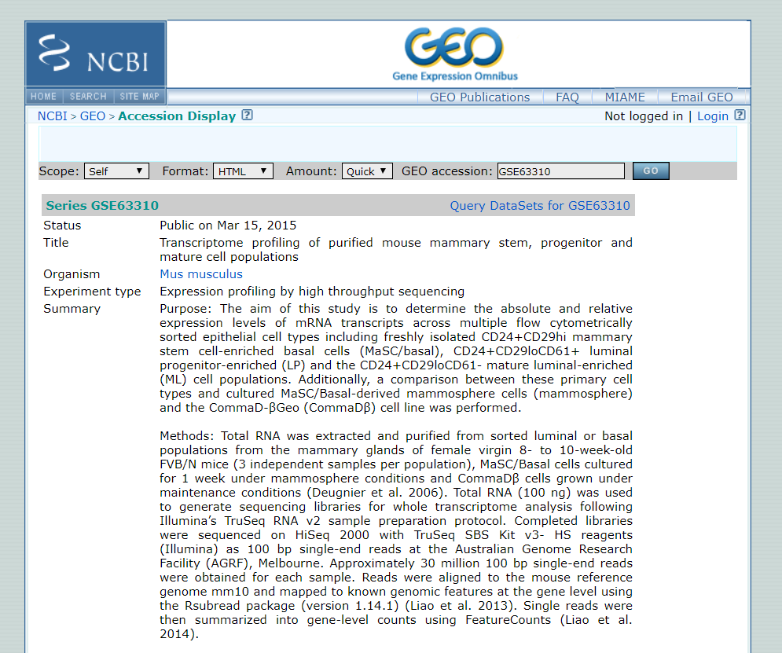
About the data
Sheridan et al. (2015)
Mouse mammary glands samples from 3 cell populations:
Basal 3 replicates
Luminal progenitor (LP) 3 replicates
Mature luminal (ML) 3 replicates
Want to compare gene expression levels between cell populations

Slide 11
Getting started
[Demo in R]
Notes:
Open Rstudio
Point out the four panes in Rstudio and mention what they are.
File > New File > R script

Slide 12
Differential expression analysis

Slide 13
limma and linear modelling
linear modelling for microarrays (and RNAseq)
Effects are estimated for parameters specified by the design matrix e.g. Condition1 and Condition2
The expressions of each gene is different but, the same model is fitted to tens of thousands of genes simultaneously.
Mean expression of Gene X
9
3
Notes:
Credit: Charity Law

Slide 14
limma and linear modelling
The design matrix is used to specify independent variables that have an influence on gene expression
e.g. experimental group, batch effects
Design matrix can be specified with or without intercept
Will focus on intercept-free design matrix here
Examples on various design matrices are available in the limma users guide

Slide 15
limma and linear modelling
Contrasts are used to find differences between the effects.
The variability in the observations determines whether the difference is considered “significant” or not (?p-value<0.05)
Mean expression of Gene X
6
9
3
Notes:
Credit: Charity Law

Slide 16
limma and linear modelling
Contrasts are used to find differences between the effects.
Variability in the observations determines whether the difference is considered significant or not (p-value<0.05?)
Sample expression of Gene X
6
9
3
Notes:
Credit: Charity Law

Slide 17
Batch effects in intercept-free model

Slide 18
RNA-seq data is
discrete (counts)
has non-constant mean-variance trend
voom
Transform to log-counts per million
Remove mean-var dependence through the use of precision weights
✔
Appropriate to assume Normality
continuous
has constant variance
Notes:
Credit: Charity Law
Let me show you what the mean-var dependence looks like …

Slide 19
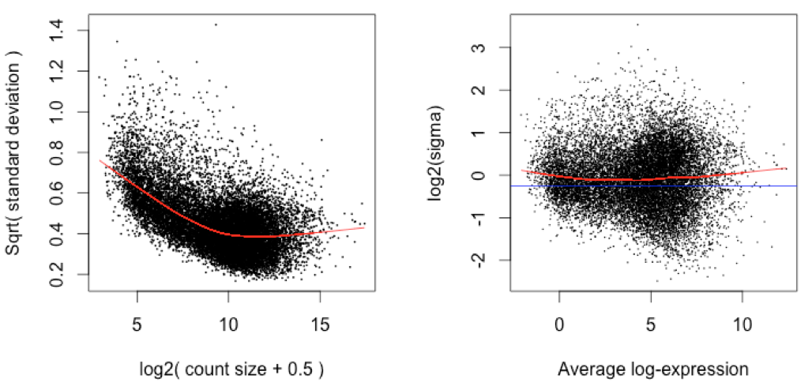
voom: variance weights
Use mean-var trend to assign weights to each observation
Weights used in linear modelling removes mean-variance trend from the data.
Before: trended variance
After: constant variance
Qtr-root variance
Log2- variance
Mean log-count
Mean log-cpm
Notes:
Credit: Charity Law

Slide 20
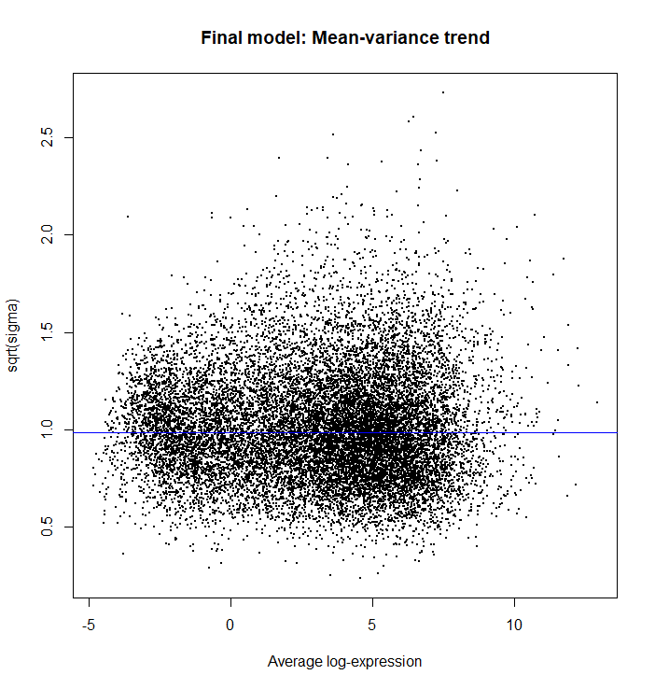
Fit linear models
Fits a linear model for each gene
Computes statistics and fold changes for comparisons of interest
> vfit <- lmFit(v, design)
> vfit <- contrasts.fit(vfit, contrasts=contr.matrix)
> efit <- eBayes(vfit)
> plotSA(efit, main="Final model: Mean-variance trend")
Computes more precise estimates by sharing gene information using empirical Bayes moderation
Plots residual standard deviation versus average log expression for fitted model

Slide 21
Sharing gene information
Experiments have small sample sizes due to sequencing cost and/or availability of samples and RNA.
Estimated variability within an individual gene is unreliable (statistically inefficient) $→$ pooling information from all genes (increases statistical power)
Empirical Bayes method: borrow information from all data to form prior information that is used to adjust observed values to values that are more precise.
In limma, a posterior variance is calculated by squeezing observed variances towards the prior variance. The posterior variance is given by
Moderated t-statistic is calculated using the posterior variance.
$$S2g=\frac{d0s20+dgs2g}{d0+dg}$$
Notes:
Credit: Charity Law
$s20$ is the prior variance
$s2g$ is the observed variance

Slide 22
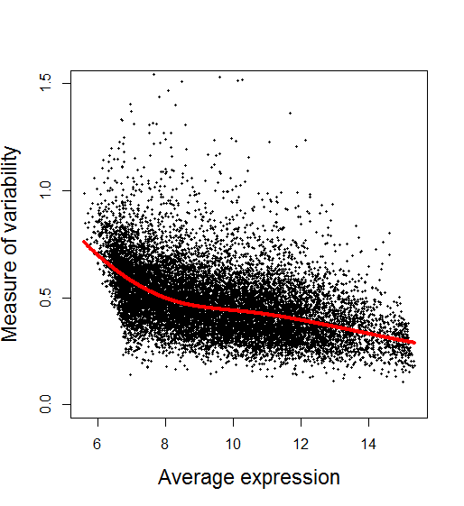
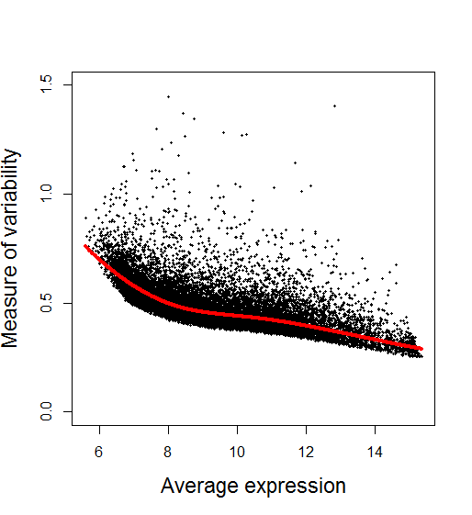
Variability before and after empirical Bayes adjustment
Before After
Slide from COMBINE workshop (edited)
Notes:
Credit: Charity Law

